Slide 1
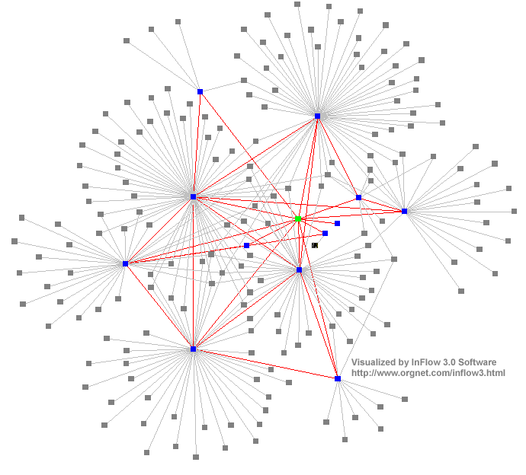
Distributed Systems :
Inter-Process Communication
(Multicast communication)
Dr. Sunny Jeong. spjeong@uic.edu.hk
With Thanks to Prof. G. Coulouris, Prof. A.S. Tanenbaum and Prof. S.C Joo
Notes:
35

Slide 2
Overview
Message passing
  send, receive, group communication
  synchronous versus asynchronous
  types of failure, consequences
  socket abstraction
Java API for sockets
  connectionless communication (UDP)
  connection-oriented communication (TCP)
  TCP UDP /UNICAST,BROADCAST,MULTICAST

Slide 3
Communication in distributed systems
Always based on low-level message passing as offered
by the Under lying network
Three widely-used models for communication
  Remote procedure call(RPC)
  Message-oriented middleware(MOM)
  Data streaming.
  and also discuss the general problem of sending data to mutilple receivers (Multicasting)
Tanenbaum & Van Steen, Distributed Systems: Principles and Paradigms, 2e, (c) 2007 Prentice-Hall, Inc. All rights reserved. 0-13-239227-5

Slide 4
Data Streaming
Unicast
1 to 1 Communication
Broadcast
1 to M Communication use C class
Using the broadcasting ip number
*.*.*.255
Multicast
1 to 1 and M Communication and use virtual Multicast IP
224.0.0.0 ~ 239.255.255.255
MultiSocket(java api)

Slide 5
Broadcast VS Multicast
Broadcast delivers streams to all the host in the broadcast domain.
Multicast routing delivers a single stream of transmitted data packets to a multicast group IP address.
in contrast with a broadcast operation, it only attempts to distribute the packet stream to the set of hosts that are part of the recipient not to all host.

Slide 6
Unicast VS Multicast
Unicast may occur serious network congestion
Multicast delivers a single stream of information to a potentially large group, with only one copy of the packet stream
result in significant traffic reduction, maximizing the use of network bandwidth.
unicast applications can use TCP or UDP at the transport layer,
multicast applications use UDP. For this reason, the application layer must provide the reliability data transfer mechanisms, such as sequence numbers, timers, and retransmissions, for multicast operations.

Slide 7
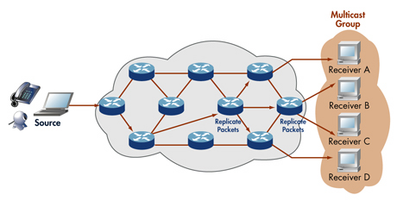
Multicast group
To communicate, need to joint the multicast group

Slide 8
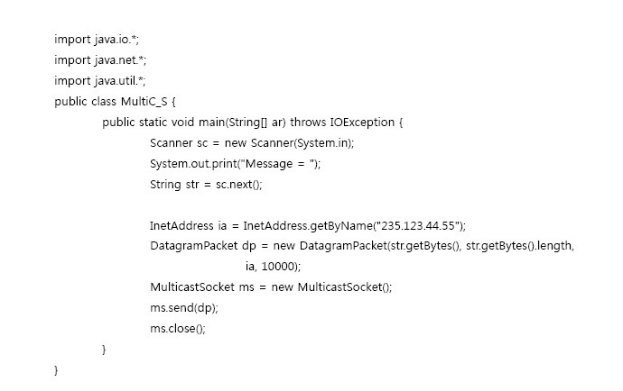
Multicast Sender

Slide 9
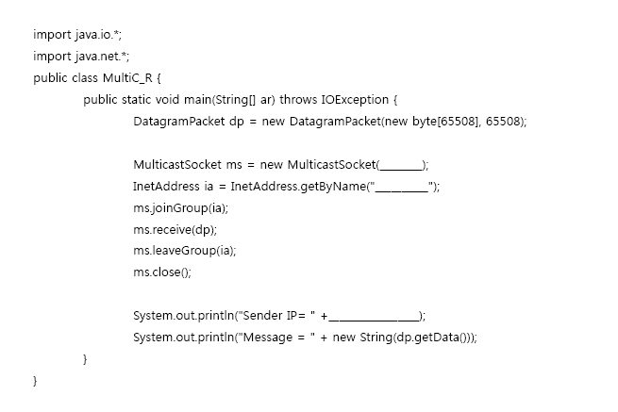
Multicast Receiver

